Slide 1
Pure Qualitative Methodology
Caleb Pope, Shayna Uhryn, & Allison Jung

Slide 2
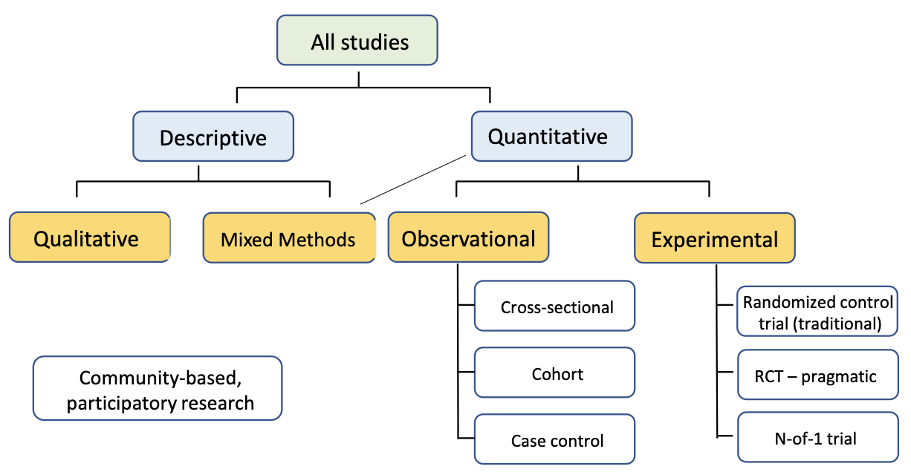
all methodologies

Slide 3
Pure Qualitative
Explain what it is
Explain why we use it

Slide 4
Examples

Slide 5
Core Principles

Slide 6
Literature example

Slide 7
Background of research (example)
Goals
Aims
Definitions

Slide 8
Critical aspects needed to understand research

Slide 9
Outline of study design
When was the method implimented

Slide 10
Explain outcomes observed

Slide 11
Results
What do the results mean
Discuss research method use

Slide 12
Study conclusions and limitations

Slide 13
Strengths & limitations of research method
Examples from literature example

Slide 14
References

